Slide 1
Vijf Visual Studio features die developement testing leuk maken.
Clemens Reijnen
Sogeti
clemensReijnen@sogeti.nl
http://www.clemensreijnen .nl
@clemensreijnen

Slide 2
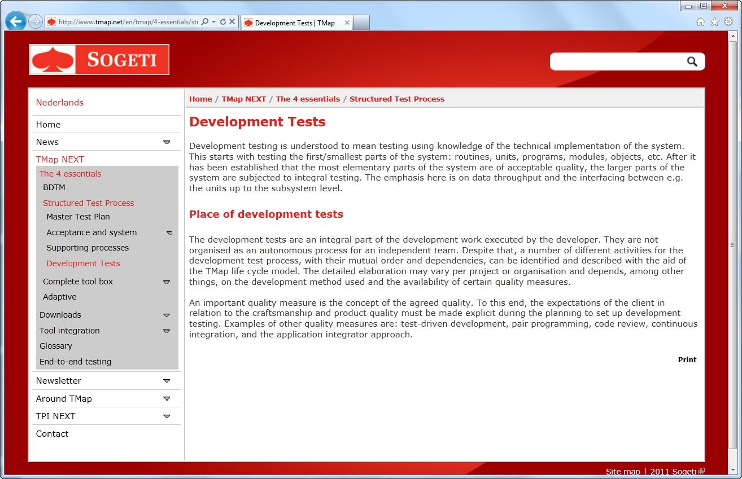
Setting the Stage
Development tests..?
Specified and executed (preferred automated) by team (with test knowledge)
Starts with (and covers) the smallest technical parts till full functional scenarios and non functional requirements.
Unit Tests
Integration Tests
Functional Tests
Acceptance Tests
Load Tests
Agreed level of quality

Slide 3
Agenda
Data Diagnostic Adapters
Test Impact Analyze
Spec Explorer
Lab Management
CodedUI
10 minutes each

Slide 4
Agenda
Data Diagnostic Adapters
Test Impact Analyze
Dev 11 Spec Explorer
Lab Management
CodedUI
10 minutes each

Slide 5

1 - Data Diagnostic Adapters

Slide 6
1 - Data Diagnostic Adapters
Capture information about the system under test.

Slide 7
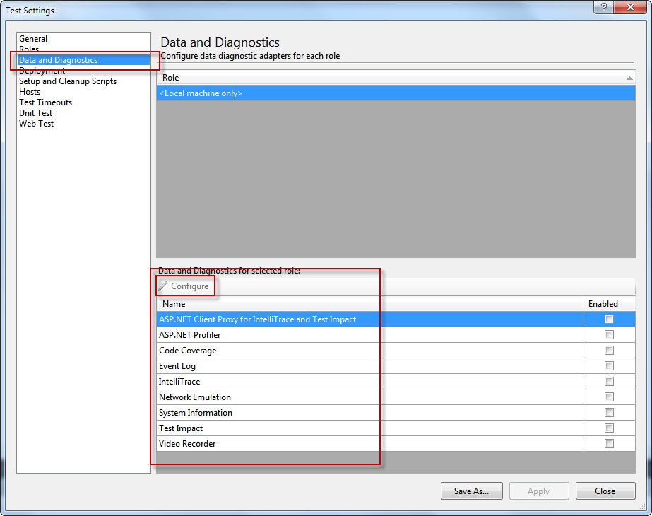
1 - Data Diagnostic Adapters

Slide 8
1 - Data Diagnostic Adapters
DEMO

Slide 9
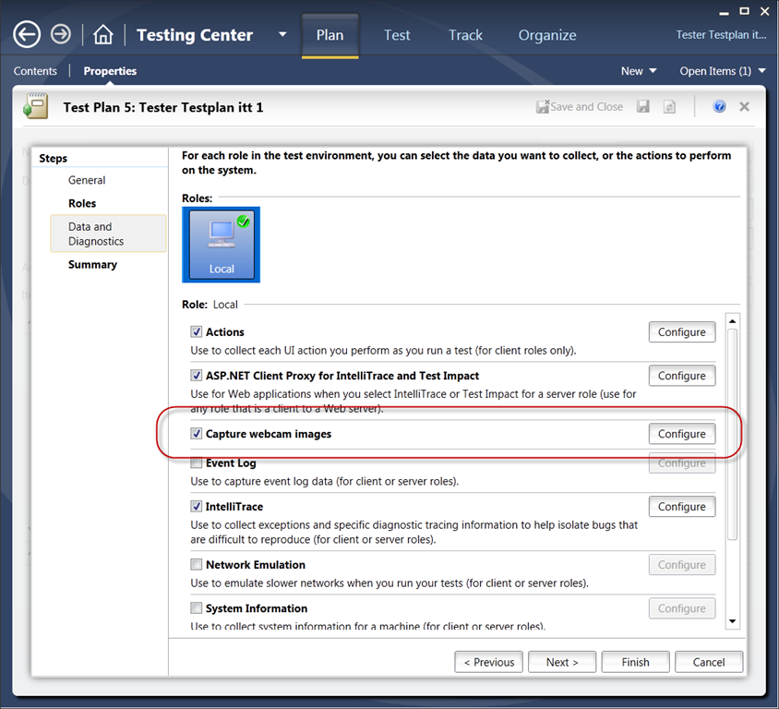
1 - Data Diagnostic Adapters
create your own

Slide 10
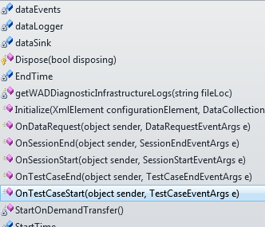
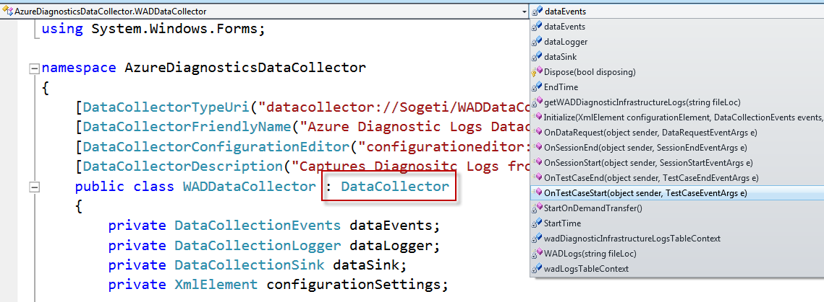
1 - Data Diagnostic Adapters
using Microsoft.VisualStudio.TestTools.Common;

Slide 11
1 - Data Diagnostic Adapters
recap:
what went wrong
http://msdn.microsoft.com/en-us/library/dd286743(VS.100).aspx

Slide 12

2 - Test Impact

Slide 13
2 - Test Impact Analyze
Get the code change

Slide 14
2 - Test Impact Analyze
DEMO

Slide 15
2 - Test Impact Analyze
recap:
Capture code changes

Slide 16
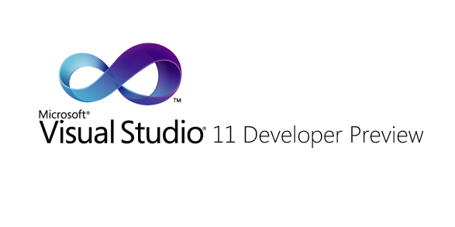
3 – Dev 11
Bike

Slide 17
3 – Dev 11
DEMO
Bike

Slide 18
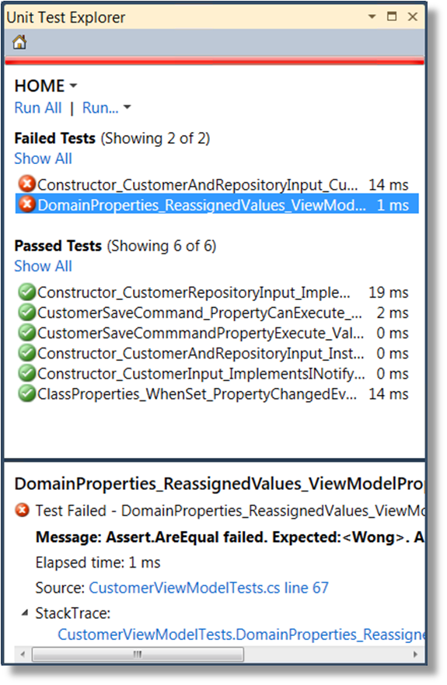
3 – Dev 11
recap:
Fast

Slide 19

3 - Spec Explorer

Slide 20
Spec Explorer
Generate test cases

Slide 21
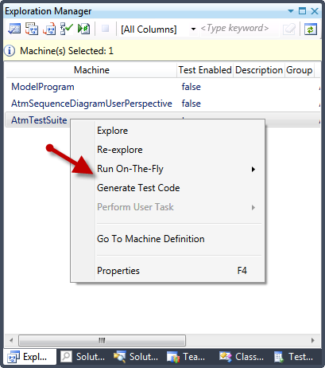
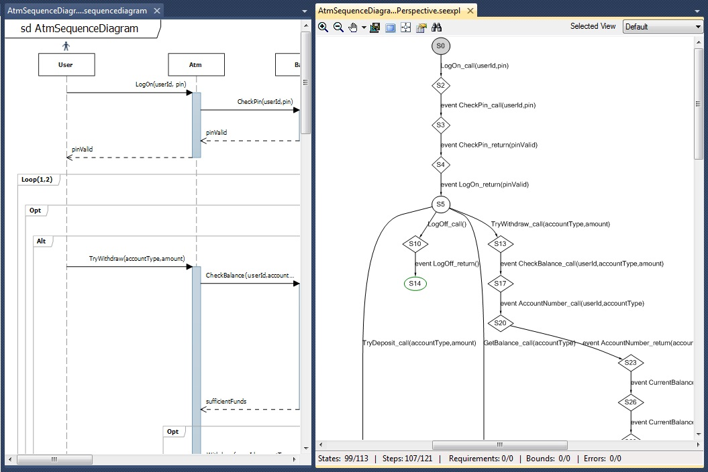
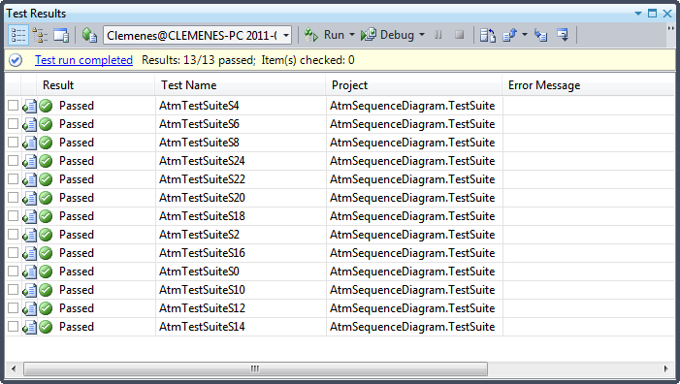
3 - Spec Explorer

Slide 22
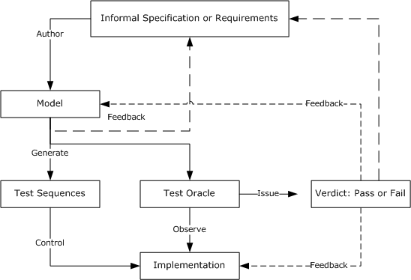
3 - Spec Explorer

Slide 23

4 - Lab Management

Slide 24
4 – Lab Management
Run tests in multiple environments
4 speed
4 environment tests

Slide 25
4 – Lab Management
DEMO
Bike

Slide 26
4 – Lab Management
recap:
Deal with environments

Slide 27

5 - CodedUI
Get tester knowledge

Slide 28
5 – CodedUI
DEMO
Bike

Slide 29
Recap
Data Diagnostic Adapters
Test Impact Analyze
Dev 11 Spec Explorer
Lab Management
CodedUI

Slide 30
